Slide 1
Basic Biological Concepts & Key Databases
DNA • RNA • Proteins • NCBI • GISAID • Ensembl • UniProt

Slide 2
Learning Objectives
Explain DNA, RNA, and protein structure/function and the central dogma.
Interpret gene structure (exon/intron/UTRs), reading frames, codons, and basic mutation types.
Recognize common sequence file formats and identifiers.
Navigate NCBI, GISAID, Ensembl, and UniProt to connect sequences, variants, and annotations.
Run quick lookups: BLAST (NCBI), VEP (Ensembl), features in UniProt.
Notes:
Emphasize practical skills and reproducible lookups.

Slide 3
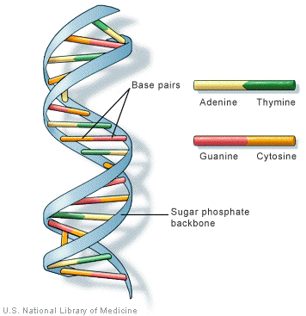
Central Dogma Overview
DNA → RNA → Protein
Replication (DNA polymerases)
Transcription (RNA polymerase → mRNA)
Translation (ribosome uses mRNA codons → polypeptide)
Regulation at each step controls expression & phenotype

Slide 4
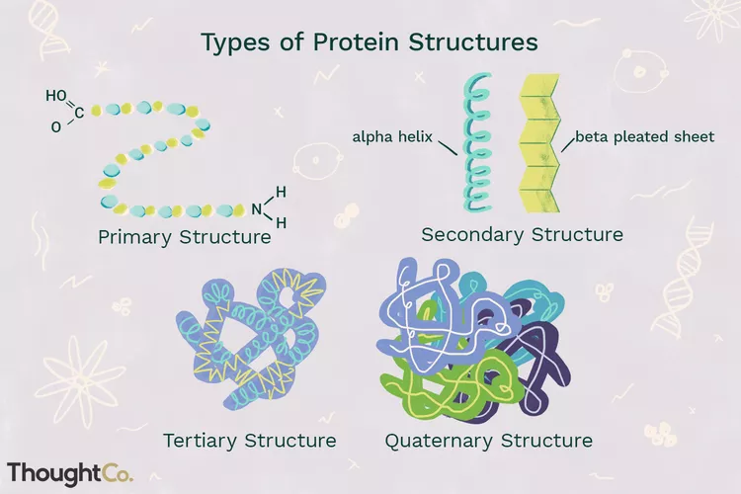
Protein Basics
Amino acids (20) → polypeptides
Primary/secondary/tertiary/quaternary structure
Motifs, domains, post-translational modifications (PTMs)
Functions: enzymes, receptors, structural, transport, immune

Slide 5
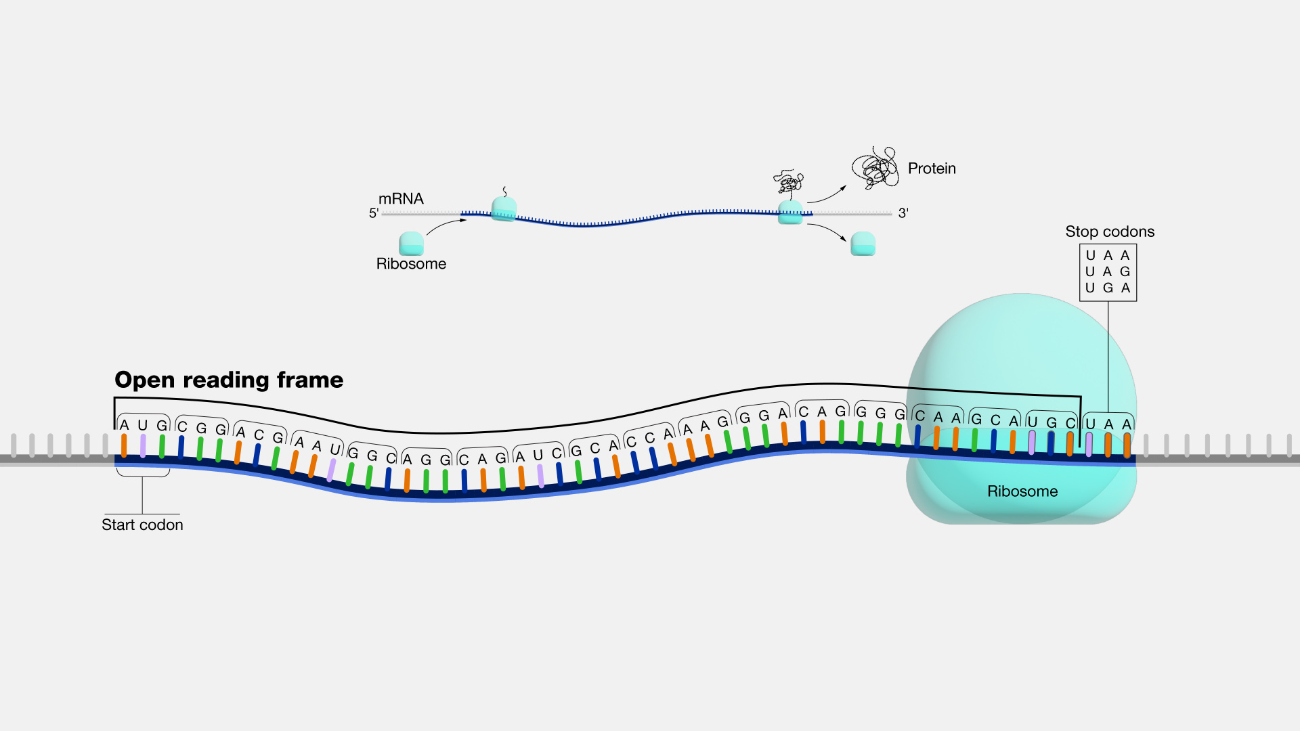
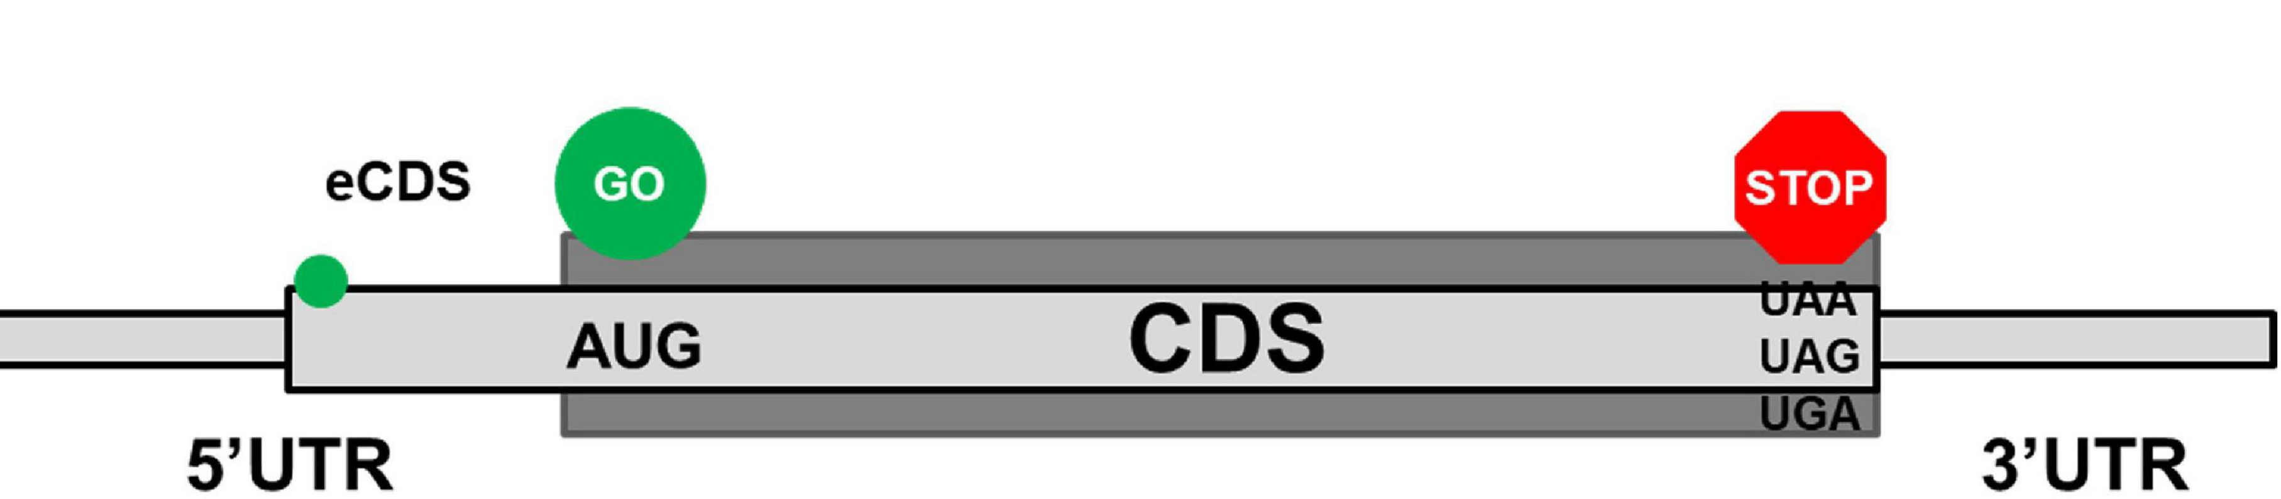
Gene Structure & Reading Frames
Promoter, 5′UTR, CDS (start ATG), stop (TAA/TAG/TGA), 3′UTR
Open Reading Frames (ORFs)
Notes:
from where transcription is initiated (promoter), through the untranslated regions (5'UTR and 3'UTR) that regulate gene expression, to the coding sequence (CDS) that contains the instructions for protein synthesis (starting with ATG and ending with a stop codon).

Slide 6
Mutation & Variant Nomenclature (Basics)
Types: substitutions, insertions, deletions, indels
Genomic vs protein-level descriptions (HGVS style)
Example: c.76A>G → p.Lys26Arg (A76G)
Synonymous vs nonsynonymous; frameshifts; indels
Lineage/clade naming in surveillance (e.g., influenza, SARS‑CoV‑2)

Slide 7
Sequence File Formats You’ll See
FASTA: headers + sequences (DNA/AA)
FASTQ: sequences with per-base quality (Phred)
GFF/GTF: genomic features & annotations
VCF: variants and genotypes
PDB/mmCIF: 3D protein structures

Slide 8
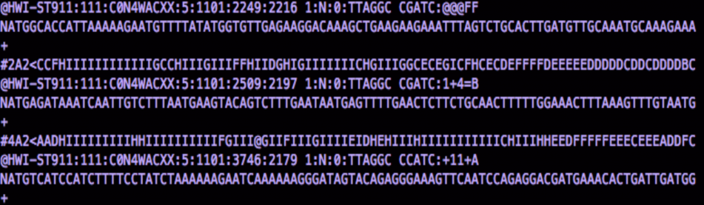
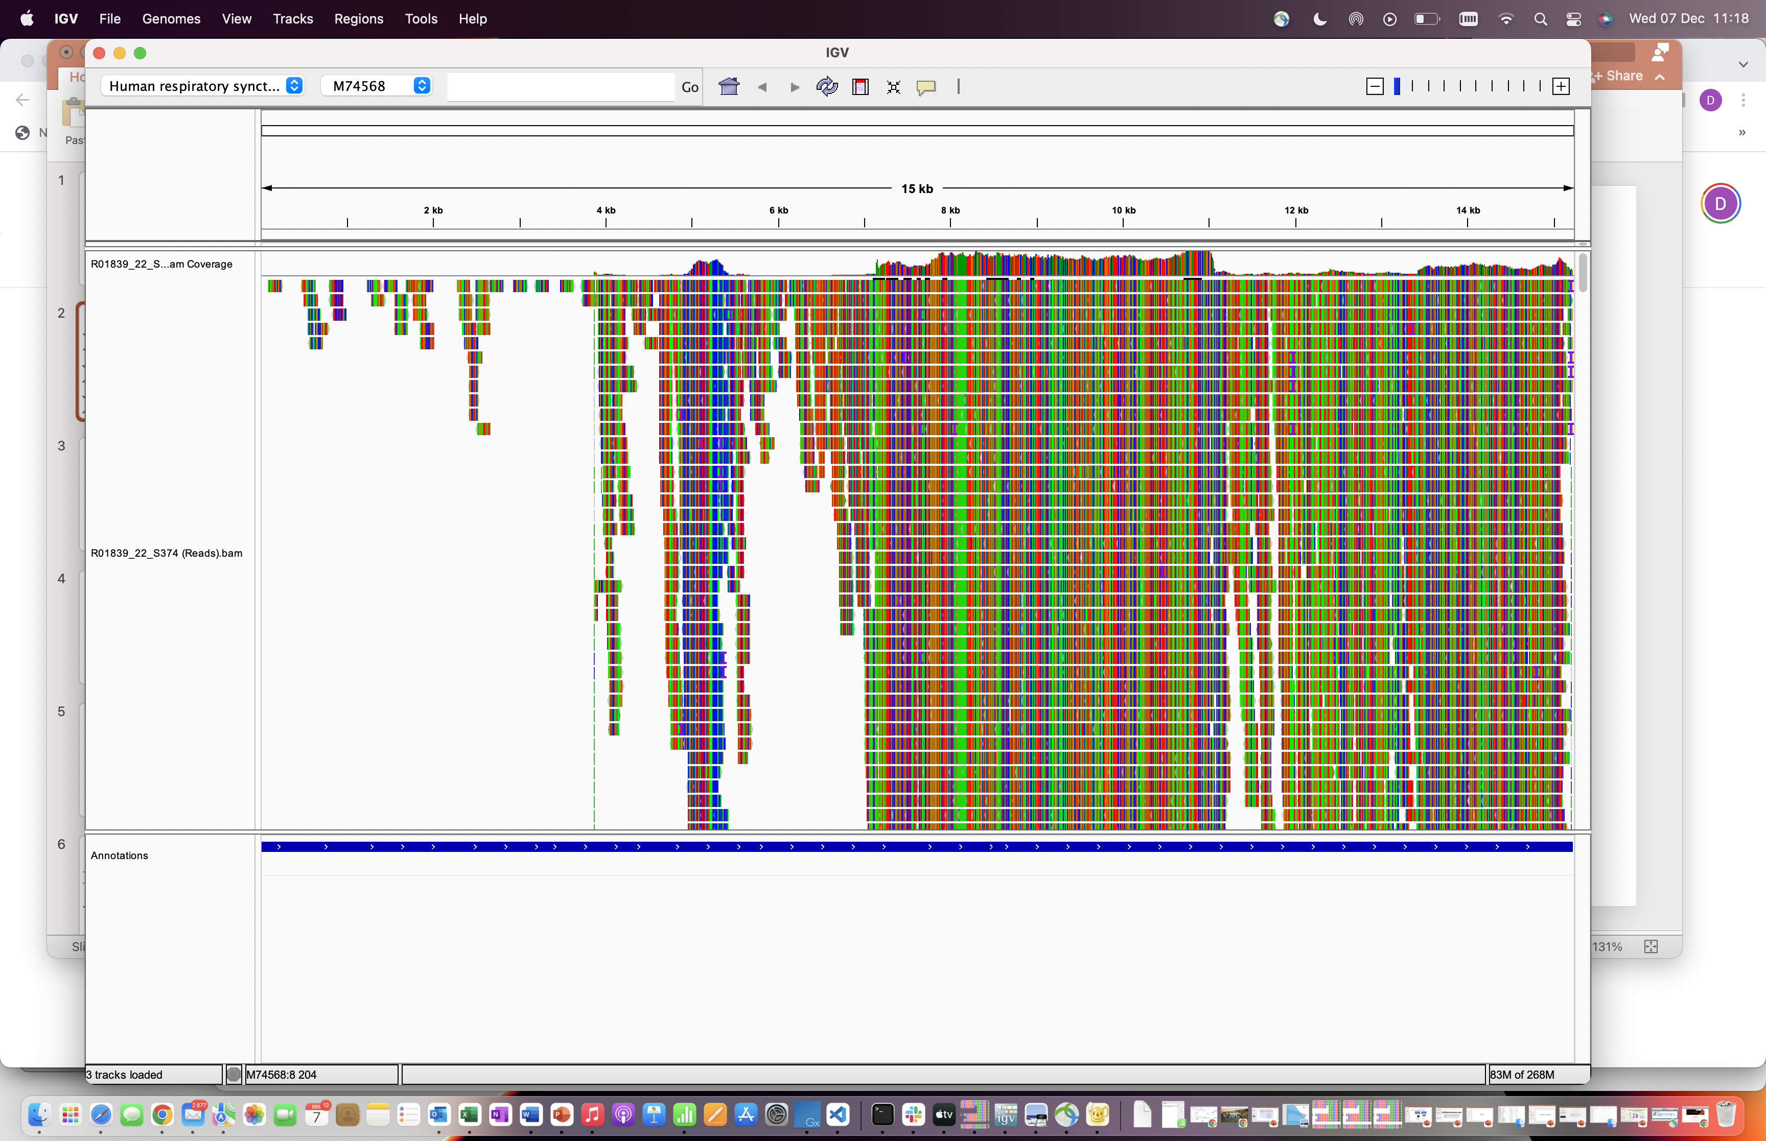
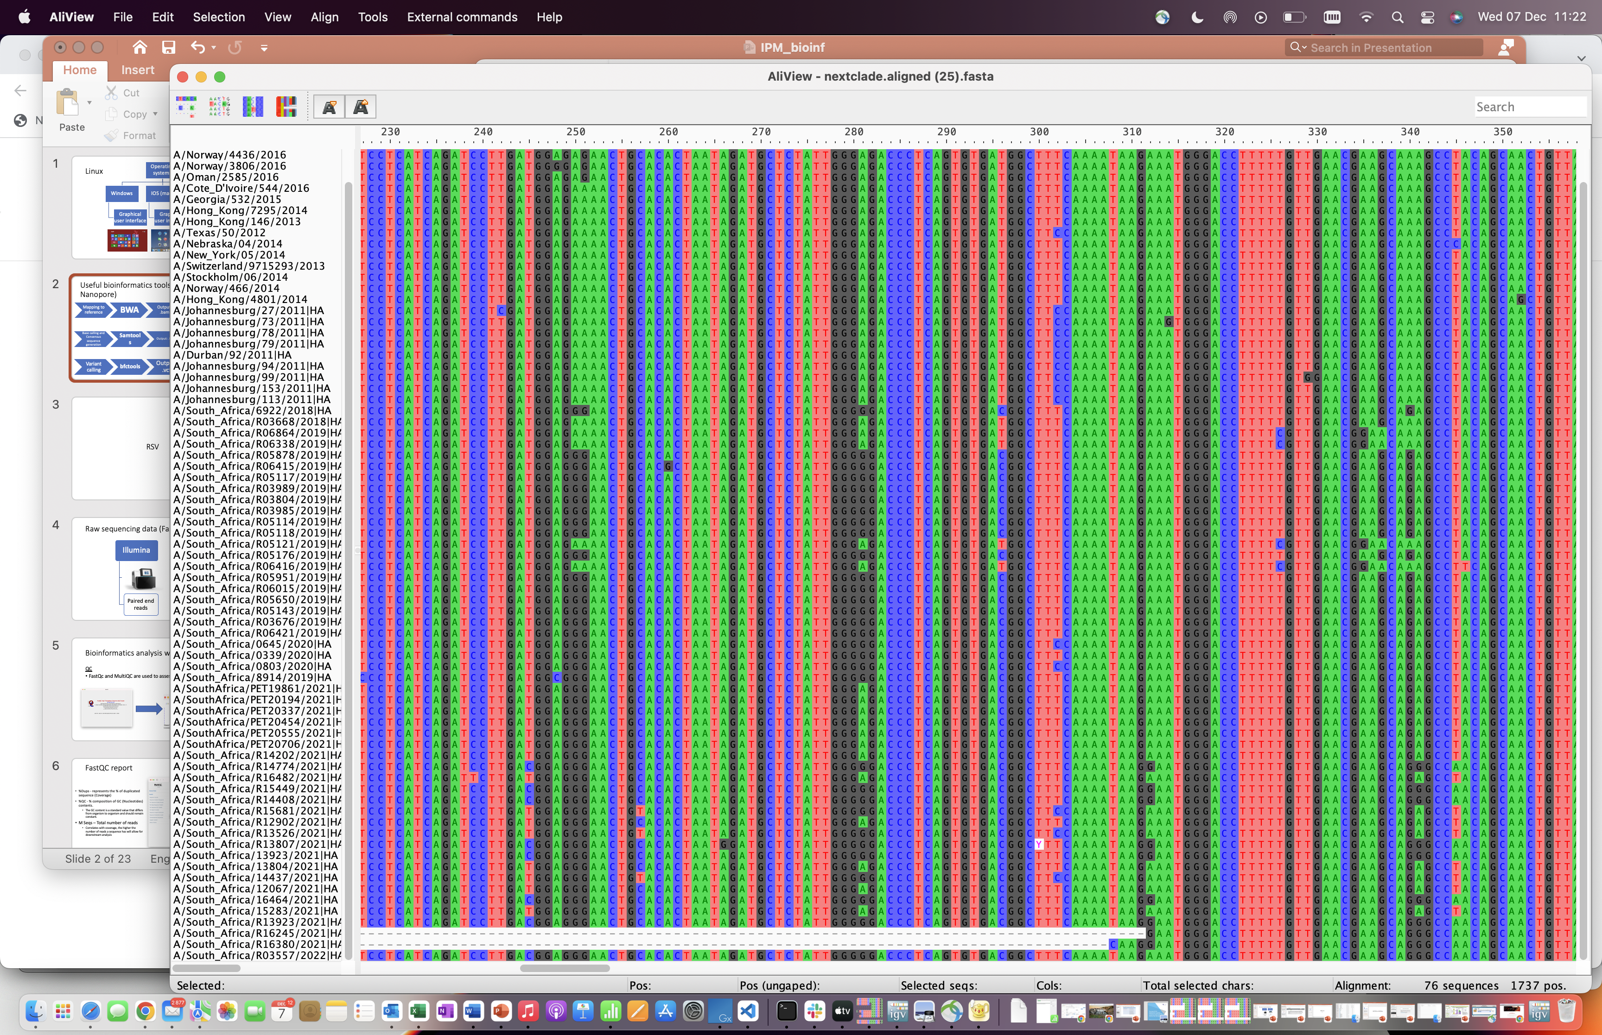
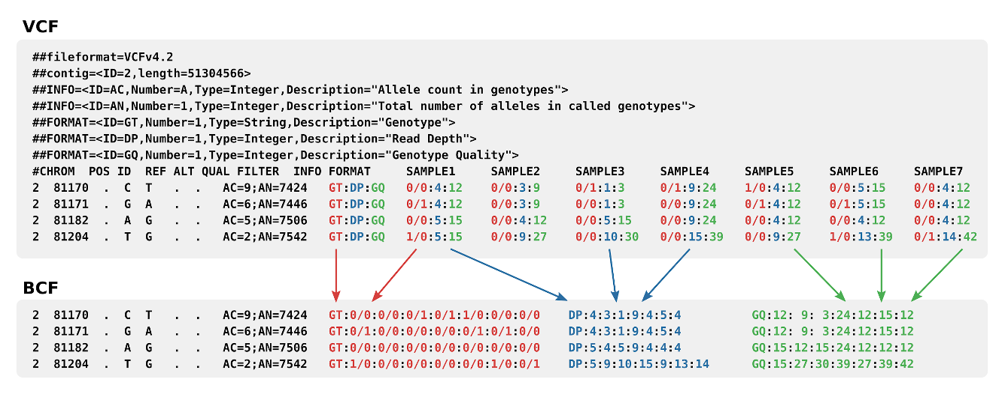
Different file formats
Raw reads
Output: .fastq.gz
FASTQ
Mapping to reference
Output: .bam
Base calling and Consensus sequence generation
Output: .fasta
Variant calling
Output: .vcf

Slide 9




From sequences to Databases
NCBI ↔ Ensembl ↔ UniProt ↔ GISAID for pathogens

Slide 10
NCBI — What It Is
National Center for Biotechnology Information
Resources: Nucleotide/Protein, BLAST, Taxonomy, GenBank/RefSeq
SRA, GEO, BioProject/BioSample
Entry search across databases with filters
Notes:
GenBank (submitted) vs RefSeq (curated).

Slide 11
NCBI — Practical Search Workflow
Start broad (organism/gene) → refine with filters
Open record → check source, features, cross-refs
Jump to Protein or BLAST
For raw reads: use SRA (SRR/ERR accessions)
Track BioProject/BioSample context

Slide 12
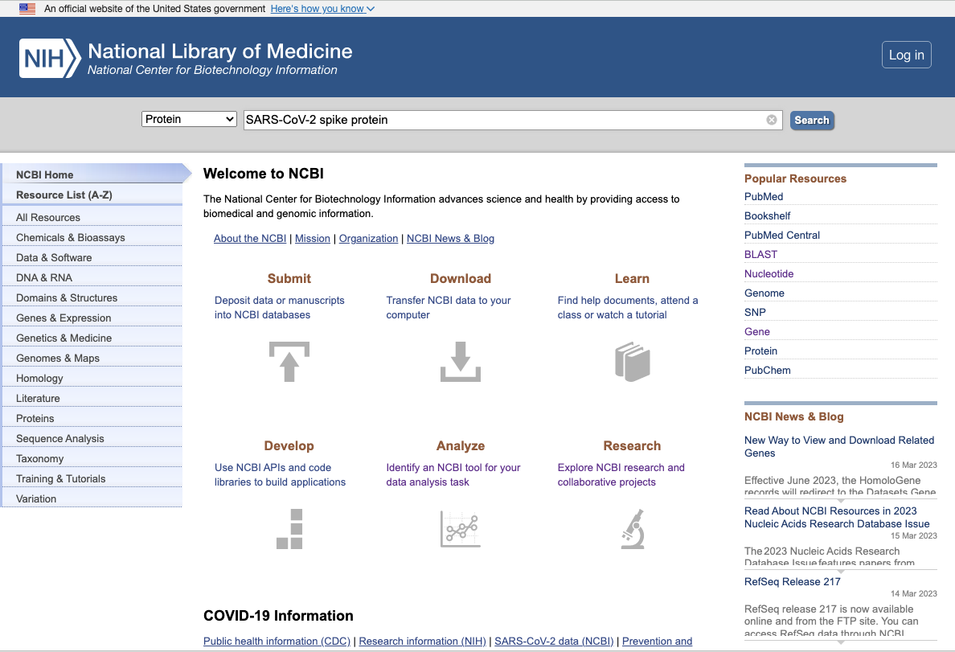
How to use the NCBI database
Let’s find the reference sequence for the SARS-CoV-2 spike protein
There are a number of ways you could go about this
We are searching the protein database of NCBI
You could also search the nucleotide database
We can search using keywords or we could input an accession number from a research paper.

Slide 13
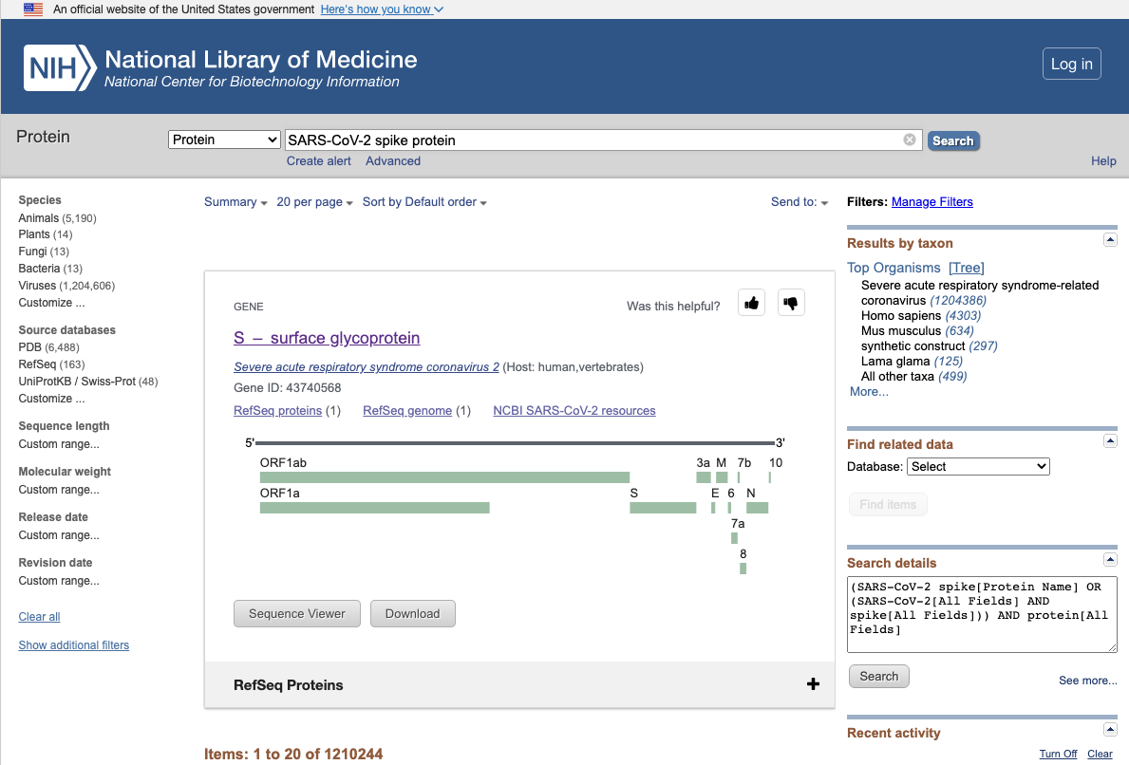
Tutorial: How to use the NCBI database
We select the RefSeq protein option

Slide 14
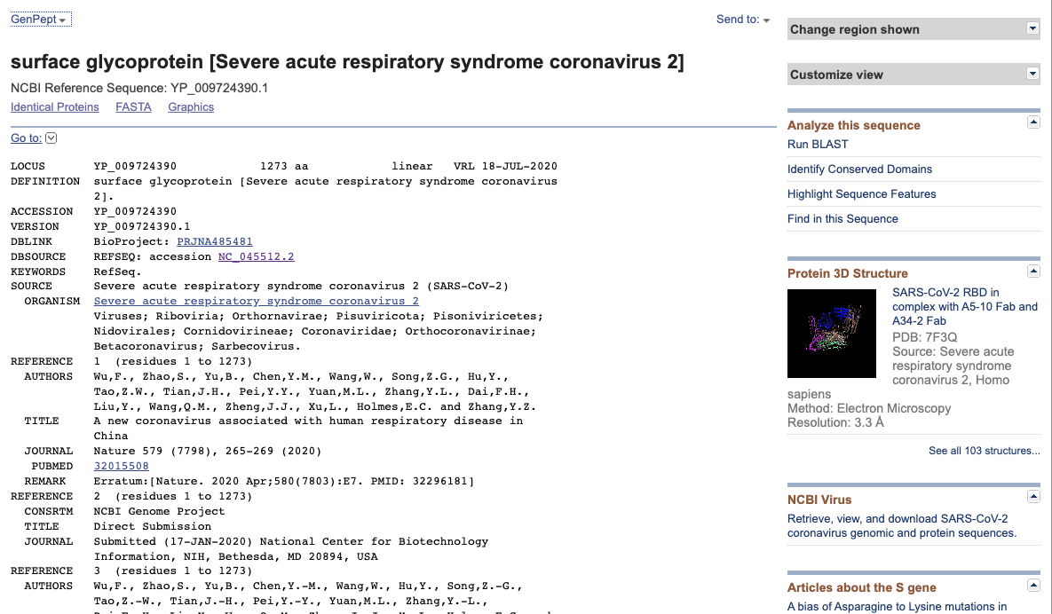
Tutorial: How to use the NCBI database
You can also download data for this entry in different formats here
This is the GenPept entry view but you can change it to just see the protein sequence in fasta format here

Slide 15
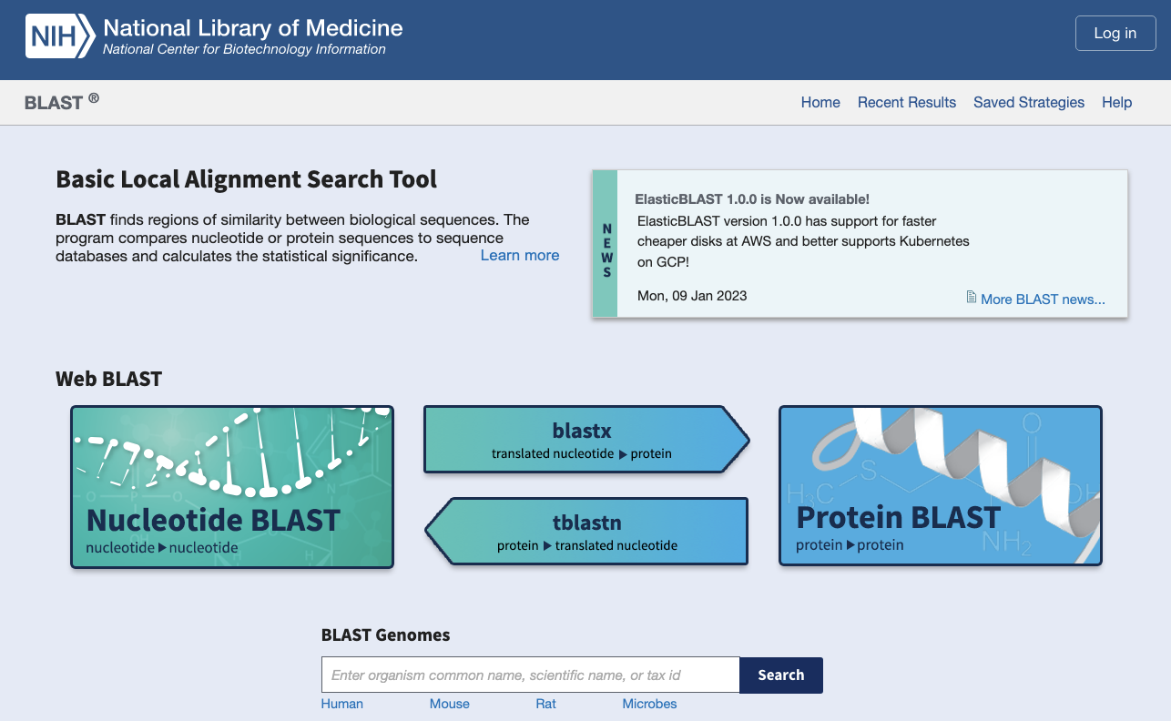
Tutorial: How to use NCBI BLAST
BLAST stands for Basic Local Alignment Search Tool
We use BLAST when we have a query sequence and we want to find similar/related sequences in the NCBI databases
Very useful for finding homologous genes i.e.: related genes in different species
Different BLAST versions: the one you use is dependent on the type of query sequence and the database you want to search against.

Slide 16
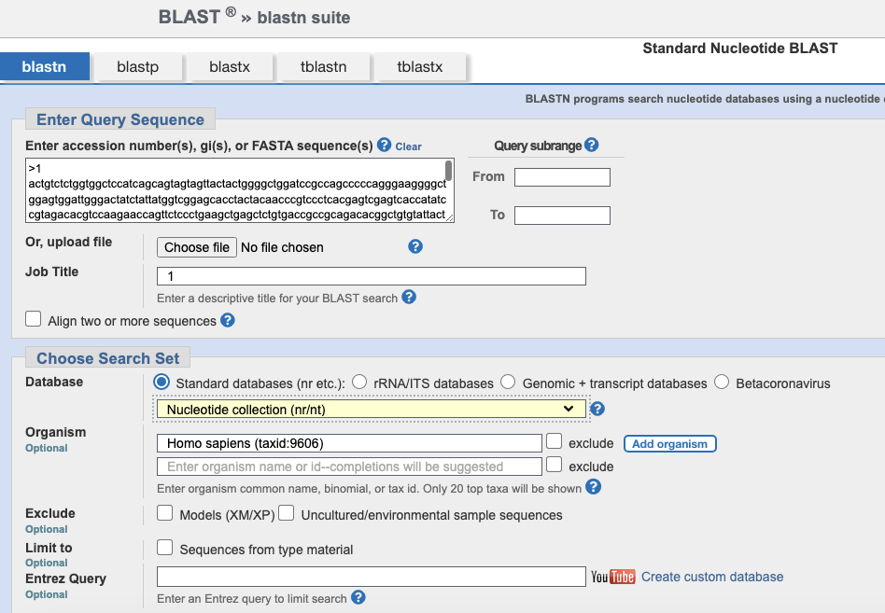
Tutorial: How to use NCBI BLAST
Paste accession number or query sequence in the search box
Try and narrow the search space to get more specific results more quickly:
Choose the NCBI database you want to search
Choose the organisms where you want to search for matches (if you know)

Slide 17
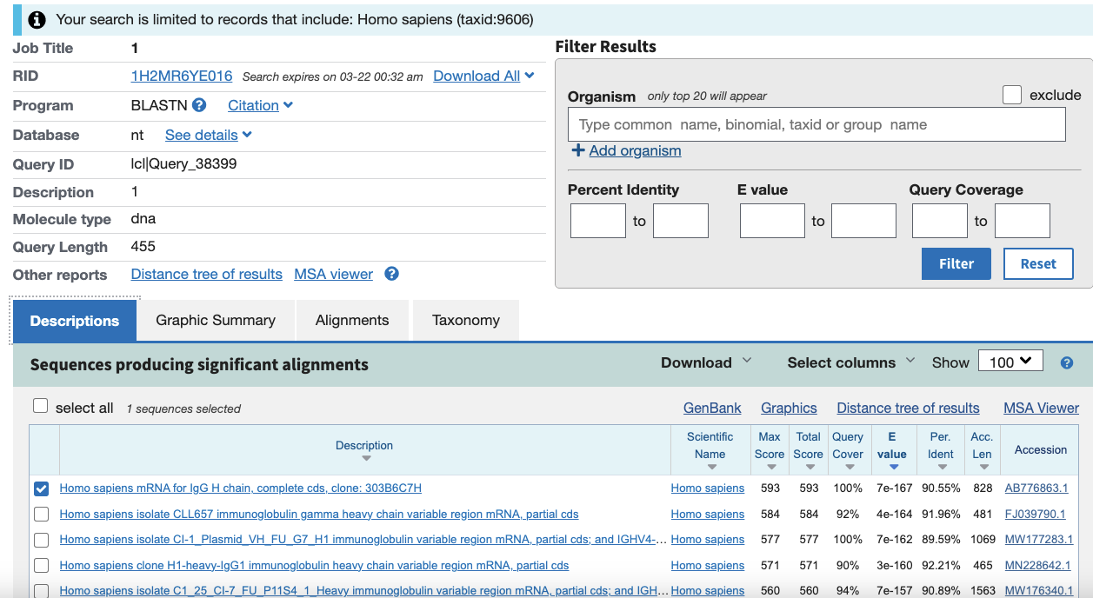
Tutorial: How to use NCBI BLAST
Important numbers:
E value: Smaller the better. Number of results we can expect to see by chance
Percent Identity: Higher the better. How well does this result match the query sequence
List of similar sequences found

Slide 18

NCBI SRA — Raw Reads
Archive of sequencing runs (short/long reads)
Key fields: instrument, platform, metadata
Download via web or CLI (fasterq-dump/prefetch)
Linkage: SRA run ↔ BioSample ↔ BioProject

Slide 19
GISAID — What It Is
Global Initiative on Sharing All Influenza Data (also EpiCoV for SARS‑CoV‑2)
Emphasis on data access agreements and acknowledgment of submitters
Curated metadata; widely used for genomic surveillance
Notes:
Respect terms of use; always cite originating/submitting labs.

Slide 20
UniProt — What It Is
Comprehensive protein knowledgebase
Swiss‑Prot (reviewed) vs TrEMBL (unreviewed)
Annotations: domains, active sites, PTMs, subcellular location
Cross‑links to PDB/AlphaFold, Ensembl, NCBI
Notes:
“UniProt is the central protein knowledgebase. It has two main sections: Swiss-Prot (reviewed, curated) and TrEMBL (unreviewed, large-scale). Entries include function, domains, active sites, PTMs, subcellular location, and variants.”
When to use it (30s)
To see what a protein does and where it localizes
To inspect domains/motifs, glycosylation, signal peptides
To connect to structures (PDB, AlphaFold) and other DBs (Ensembl/NCBI)

Slide 21
Ensembl — What It Is
Genome browser & annotation project (EMBL‑EBI)
Genes, transcripts/exons, variants, comparative genomics
Cross‑references to NCBI & UniProt; API & BioMart for bulk queries
Notes:
Ensembl is a genome browser and annotation project from EMBL-EBI. It focuses on gene models, transcripts, exons/introns, comparative genomics, and variants. It’s gene-centric and species-rich, with APIs and BioMart for bulk queries.”
Visualize gene structure and transcripts; export CDS/protein
Map variants to transcripts and interpret consequence
Retrieve orthologs/paralogs or comparative genomics info

Slide 22
Quick: Where to Find What
NCBI: sequences, BLAST, SRA raw reads, taxonomy
GISAID: curated pathogen genomes + metadata (with acknowledgments)
Ensembl: genome browser, gene models, comparative genomics
UniProt: protein function, domains, PTMs, variants, cross‑refs

